Slide 1
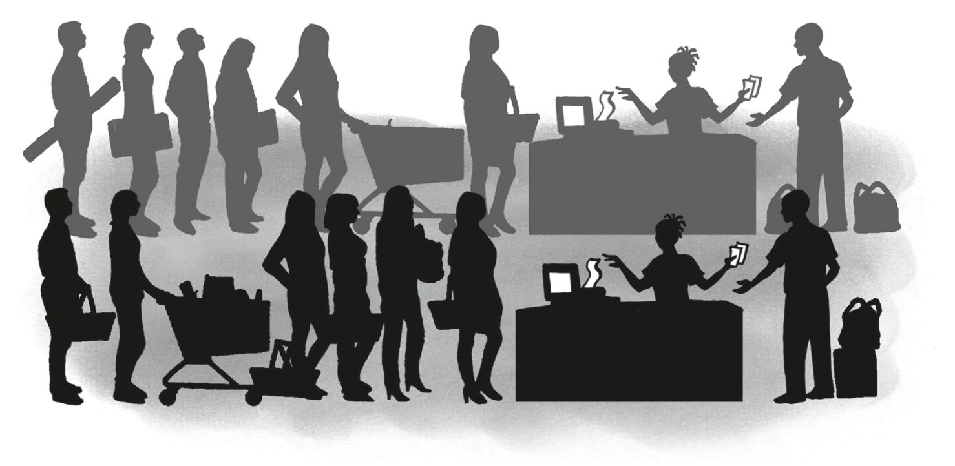
EMS: Source Documents
Source Documents: receipts, bank deposit slips, cash register slips

Slide 2
What are we going to learn?
Analyse receipts
Consider deposit and cash register slips
Find out about cheques and cheque counter foils
Research bank statements
Look into cash invoices

Slide 3
Let’s revise
Transaction
A transaction is an event between two or more people where money is involved
Source document
A source document is the recording of the details of a transaction
Cash receipts
refer to the money received in a business
Cash payments
refer to money paid out by a business

Slide 4
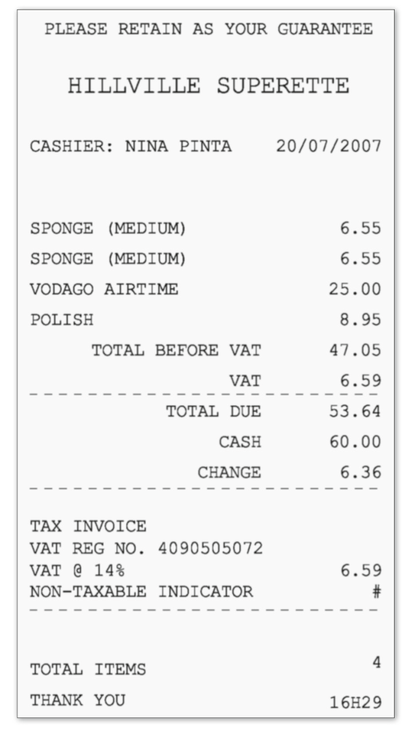
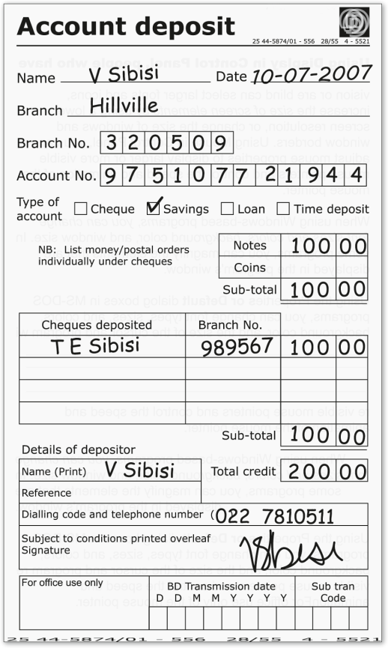
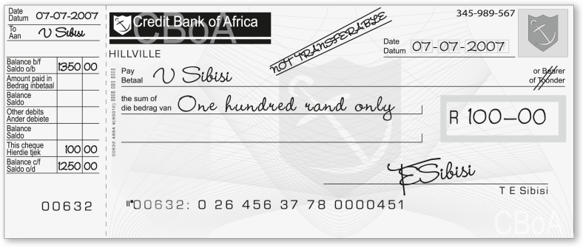
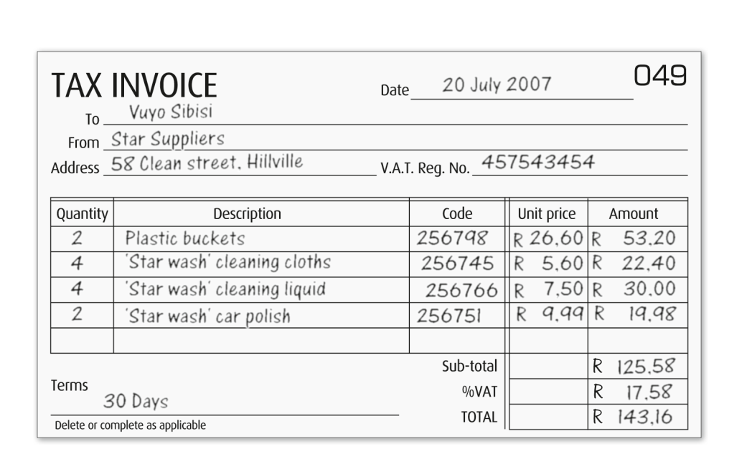
Different document in a business
Different document in a business

Slide 5
Receipts
Source documents of money that has been received
Filled in duplicate
Two identical receipts
Original receipt
Issued to the business/person where the money was received from
Duplicate receipt
Is kept by the business and
Used to enter the transaction

Slide 6
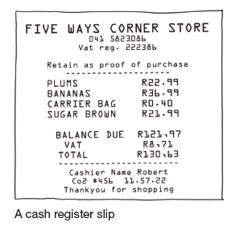
Receipts
An example of a receipt

Slide 7
Let’s do it together
1. When is a receipt issued?
Answer: A receipt is issued when money is received from customers
2. To whom is the receipt issued?
Answer: Abigale Ndlovu
3. For what is the receipt issued and for
what amount?
Answer: Rent, R5 000
4. If you paid someone cash, why would
you want a receipt?
Answer: As proof that you paid money

Slide 8
Bank deposit slips
Money deposited by the business, a bank deposit slip must be completed
The total receipts for the day
Cash, cheques, credit card slips and all other means of payment
It is not safe for a business to keep a lot of money on the premises
Money must be deposited daily
Deposit money to ensure cash flow
Money is available to make payments

Slide 9
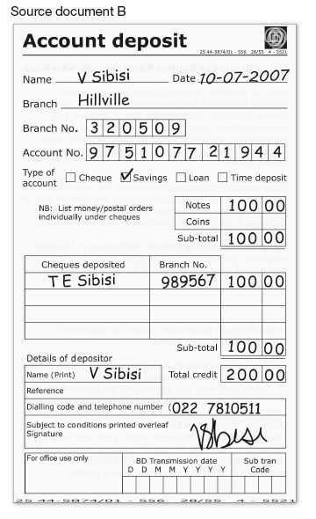
Bank deposit slips
An example of a bank deposit slip

Slide 10
Let’s do it together
What is the document used for?
Answer: To deposit money into the bank account
2. What is the branch and branch
code of the bank?
Answer: Hillville, 320509
3. What type of account is it?
Answer: Savings
4. What is the total amount of the deposit?
Answer: R200

Slide 11
Let’s do it together
5. Why do you think the bank wants to know whether you have deposit money in cash notes , coins or cheques?
Answer: The cashier has to total the amounts received and pay-outs

Slide 12
Cash register slips
Proof that a transaction has taken place
The slip gives information about
Where, what date and what was purchased
How much it cost and the amount of change given
Cash registers have two rolls on which till slips are printed.
One roll prints out the customer’s till slips
The other roll prints out duplicates of all the transactions – this roll remains inside the cash register. We call this a cash register roll

Slide 13
Cash register slips
At day end, the total of the cash register roll should correspond with the total amount of money in the cash register less the cash float
The cash register roll is used as the source document to record all receipts for the day

Slide 14
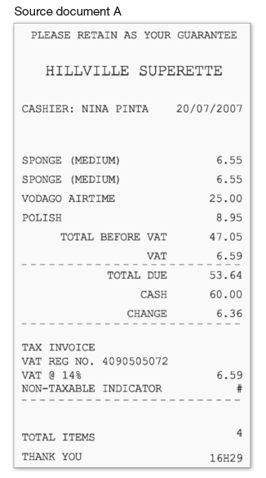
Cash register slips
An example of a cash register slip

Slide 15
Let’s do it together
Where were the items on this document bought?
Answer: Hillville Superette
2. Why is this document a tax invoice?
Answer: VAT is charged on some items
Did the person pay tax on all the items
he or she bought? Why or why not?
Answer: No, some items are standard rate
and others are zero-rated
How much VAT did the person pay?
Answer: R6,59

Slide 16
QUESTIONS?

