Slide 1
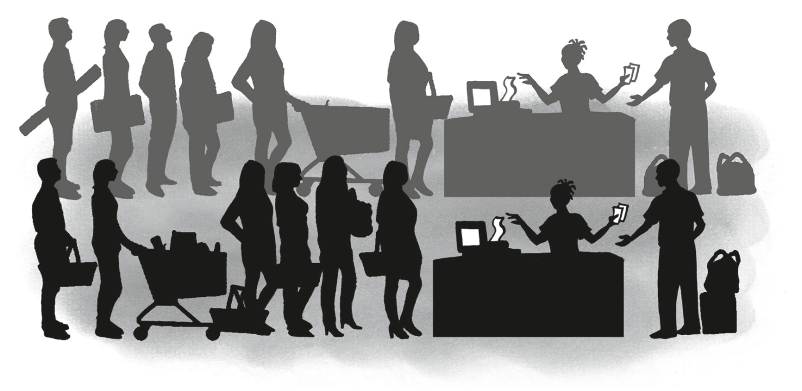
Economic and Management Sciences
Source Documents
(Oxford Successful)

Slide 2
What are we going to learn?
Analyse receipts
Consider deposit and cash register slips
Find out about cheques and cheque counter foils
Research bank statements
Look into cash invoices

Slide 3
Let’s revise
Transaction
A transaction is an event between two or more people where money is involved
Source document
A source document is the recording of the details of a transaction
Cash receipts
Refer to the money received in a business
Cash payments
Refer to money paid out by a business

Slide 4
Different documents in a business

Slide 5
Receipts
Source documents of money that has been received
Filled in duplicate
Two identical receipts
Original receipt
Issued to the business/person where money was received from
Duplicate receipt
Is kept by the business and
Use to enter the transaction

Slide 6
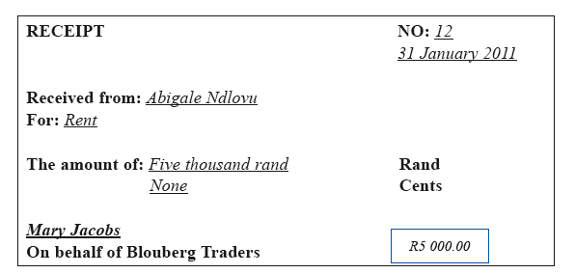
Receipts
An example of a receipt

Slide 7
Let’s do it together
1. When is a receipt issued?
Answer: A receipt is issued when
money is received from customers
2. To whom is the receipt issued?
Answer: Abigale Ndlovu
3. For what purpose is the receipt
issued and for what amount?
Answer: Carpet Cleaning, R5,000
4. If you paid someone cash, why
would you want a receipt?
Answer: As proof that you paid money

Slide 8
Bank deposit slips
When money is deposited by the business, a bank deposit slip must be completed
The total receipts for the day
Cash, cheques, credit card slips and all other means of payment
It is not safe for a business to keep a lot of money on the premises
Money must be deposited daily
Deposit money to ensure cash flow
Money is available to make payments

Slide 9
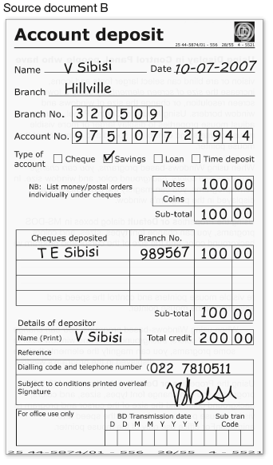
Bank deposit slips
An example of a bank deposit slip

Slide 10
Let’s do it together
What is the document used for?
Answer: To deposit money into the bank account.
2. What is the branch and branch code of the bank?
Answer: Hillville, 320509
3. What type of account is it?
Answer: Savings
4. What is the total amount of the deposit?
Answer: R200

Slide 11
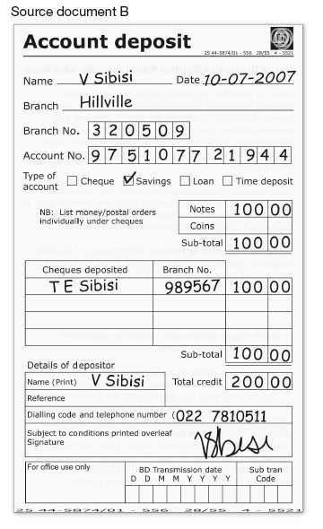
Let’s do it together
5. Why do you think the bank wants to know whether you have deposited money in cash notes, coins or cheques?
Answer: The cashier has to total the amounts received and pay-outs

Slide 12
Cash register slips
Proof that a transaction has taken place
The slip gives information about
Where, what date and what was purchased
How much it cost and the amount of change given
Cash registers have two rolls on which till slips are printed
One roll prints out the customer’s till slips
The other roll prints out duplicates of all the transactions – this roll remains inside the cash register, we call this a cash register roll

Slide 13
Cash register slips
At day end, the total of the cash register roll should correspond with the total amount of money in the cash register less the cash float
The cash register roll is used as the source document to record all receipts for the day

Slide 14
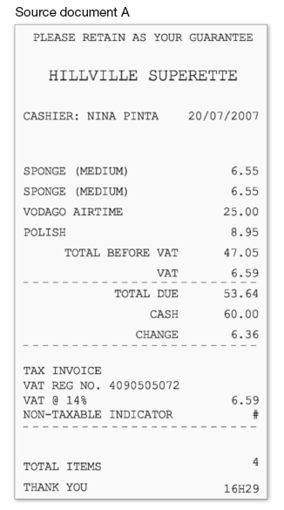
Cash register slips
An example of a cash register slip

Slide 15
Let’s do it together
Where were the items on this document bought?
Answer: Hillville Superette
2. Why is this document a tax invoice?
Answer: VAT is charged on some items
Did the person pay tax on all the items
he or she bought? Why or why not?
Answer; No, some items are standard rate
and others are zero-rated.
How much VAT did the person pay?
Answer: R6,59

Slide 16
Cheques
A document used to withdraw money from a current bank account
When a business writes out a cheque it should:
have more than one person sign a cheque to prevent fraud
as far as possible, not write out a cash cheque
Do all payments by cheque and not out of the cash register

Slide 17
Cheque counterfoils
Part of the cheque that remains in the cheque book that is used to record transactions from
Contains a summary of all information that appears on a cheque
Each cheque has a counterfoil that is bound into the cheque book and cannot be removed
A perforated line separates the cheque and the counterfoil
so that the cheque can be removed with ease from the cheque book, after it has been completed

Slide 18
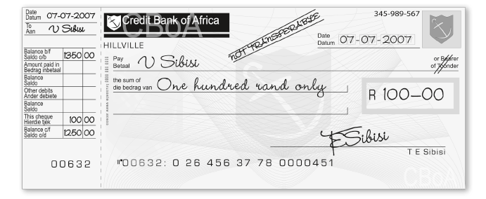
Cheques and cheque counterfoil
An example of a cheque and cheque counterfoil

Slide 19
Let’s do it together
What is the document called?
Answer: Cheque and cheque counterfoil
What is it used for?
Answer: For payments
What is Mrs Sibisi’s bank account numbers?
Answer: 0264563778

Slide 20
Let’s do it together
Why is the amount written in words and in numbers?
Answer: It is written in words and numbers so that another person cannot change the amount (to prevent fraud)
5. Why has the cheque been crossed?
Answer: The amount will only be paid out to Mrs Sibisi and not
to somebody else
6. Which part of the cheque did Mrs Sibisi keep for her own records?
Answer: Cheque counterfoil

Slide 21
Bank statements
A bank statement is a record of the account holder’s transactions over a set period of time
Bank accounts:
All business use some type of bank account
Example of bank accounts include savings accounts, transmission accounts, fixed investment accounts, credit card accounts and cheque accounts
Every time the business does a transaction via the bank, it will have an impact on the bank account of the business

Slide 22
Bank statements as resource documents
The bank records all its clients’ transactions
At least once a month the bank sends a statement that shows a record of transactions
This is called a bank statement
Often a business’s cash entries and the entries made on the bank statement are not exactly the same
The business might not have seen certain charges, such as bank charges until it receives the bank statement, or/and;
Some cash entries that the bank has not yet recorded, example some cheques have not been cashed

Slide 23
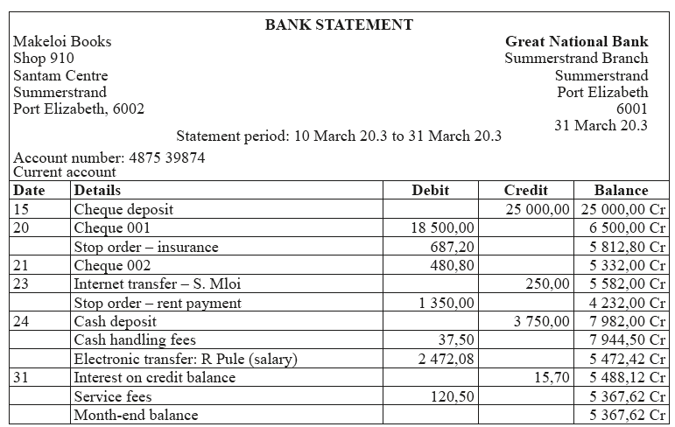
Example of bank statement

Slide 24
Let’s do it together
What is the name of Makeloi’s bookshop
Answer: Makeloi Books
At which bank does Makeloi have a bank account
Answer: Great National Bank
3. What kind of bank account did
Makeloi open and when did she open it?
Answer: Current account, 10 March
4. Give the physical address for Makeloi’s
bookshop
Answer: Shop 910, Santam Centre, Summerstrand
Port Elizabeth

Slide 25
Let’s do it together
What was Makeloi’s capital contribution?
Answer: R25 000
What was the initial cost of books
Makeloi bought?
Answer: R18 500
7. How many people does Makeloi
employ in the shop and what are
they paid?
Answer: One, R2 472,08

Slide 26
8. Why did Makeloi received interest?
Answer: She has money in the bank
What is the rent Makeloi paid
this month?
Answer: R1 350
10. What is the month-end balance on
the bank account?
Answer: R5 367,62
.

Slide 27
Let’s do it together
11. What is the difference between a
stop order and a debit order?
Answer: Stop order = instruction by the
client to the bank to pay a certain amount,
the bank initiates the payment
Debit order = instruction by the client to
the payee, the payee initiates the
withdrawal from the bank by magnetic tape

Slide 28
How much did Makeloi have to pay the bank
for service fees?
Answer: R37, 50 + R120,50 = R158
14. What is the accounting term for
service fees charged by the bank?
Answer: Bank charges

Slide 29
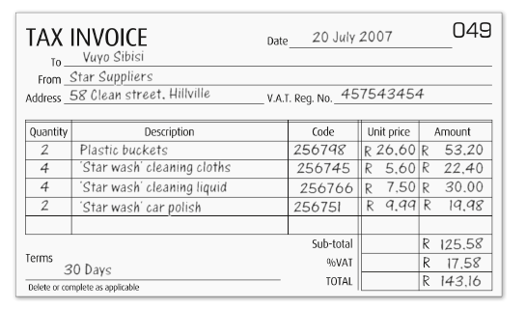
Cash Invoices
Some businesses do not use a cash register to issue slips as proof of goods bought but use a cash invoice instead
Cash invoices are normally done on a computer and printed out
They contain important information, such as quantity, description, unit price and amount
An example of a cash invoice is on this page

Slide 30
Cash invoices
What is the unit price of the buckets?
Answer: R26, 60
2. Why do you think the items have codes?
Answer: Secret codes are used in the business for the cost price of goods sold.
3. What is the total amount, excluding VAT, that the person spent at Star Suppliers? Answer: R125,58
4. On what terms did they buy the goods?
Answer: 30 days

Slide 31
QUESTIONS?

