Slide 1
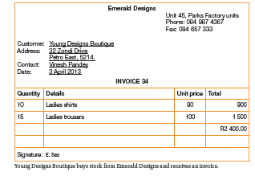
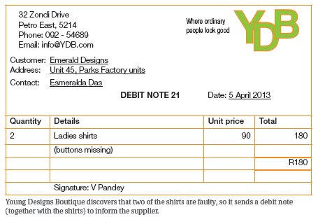
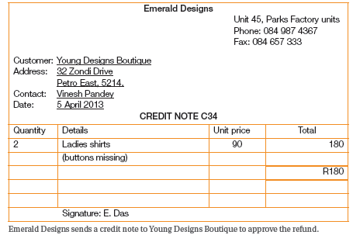
EMS: Credit Transactions (Creditors)

Slide 2
What are we learning?
In this unit you will cover:
Creditors
Creditors allowances
Accounting cycle
Recording transactions in the Creditors Journal (CJ)
Recording transactions in the Creditors Allowances Journal (CAJ)

Slide 3
Before we start answer the questions
1. Give another name for a debtor
Answer: Customer
Identify the two prices that are involved in credit sales
Answer: Cost price and selling price
Explain the triple-entry system
Answer: The triple-entry system means that the transaction is recorded in two separate accounts in the General Ledger as well as in the individual debtors account in the debtors ledger.
4. Discuss why the triple-entry system is used
Answer: To keep track of all transactions affecting debtors; to ensure that the debtors control account correlates with the total debt owing by the debtors; internal control system.

Slide 4
ACCOUNTING CONCEPTS RELATING TO CREDIT PURCHASES
Source Documents
Trade Discount
Creditor
Credit Allowance
Supplier

Slide 5
Creditors
Another name for a creditor is a supplier
Suppliers provide a business with any goods and services
Trading stock, accounting services and stationery
If you buy something on credit, you can take the item and only pay later
Advantages:
Goods can be sold and received before the business has to pay for the stock
It helps with cash flow

Slide 6
Let’s do it together
Give another name for a creditor.
Answer: Supplier
2. Describe a possible transaction involving a creditor.
Answer: Purchased goods or services on credit from supplier
Do you think all credit transactions should go in the same journal? Explain your answer.
Answer: No. There is a difference between the business purchasing on credit and selling on credit. The business owner must be able to check the amount he owes his suppliers as well as how much the customers owe him at any time This can be done only if these two types of credit entries are treated separately.

Slide 7
Let’s do it together
4. Draw a timeline if the business is allowed 60 days to pay for trading stock purchased on credit but sells the goods within 40 days
Answer: Use discretion. The timeline must clearly show that the stock is sold and cash is received before the business has to pay for the stock
5. How will the above scenario affect the business cash flow? Explain your answer using your own amounts as examples.
Answer: It will improve the business cash flow. The credit amount has to be paid only after the business has received the money from selling them at a profit. It is as if the business has borrowed the money from the supplier, interest free.

Slide 8
Trade Discount
Sometimes a business will receive a special discount from the supplier. Why?
For buying a large quantity of products
This discount is not shown in the records of a business
Cost – discount = net figure is used

Slide 9
Creditors Allowance
Return goods to the supplier because they are faulty or damaged.
A credit allowance reduces the amount the business owes the supplierd

Slide 10
Source documents
When goods are purchased, the business receives an invoice with the goods.
The business sends a debit note, together with damaged goods, requesting an allowance for these goods.
The supplier sends a duplicate credit note approving the allowance.
The below illustrations show how it works.

Slide 11
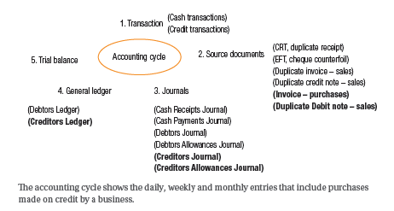
ACCOUNTING CYCLE
Shows daily, weekly and monthly entries that include purchases made on credit by a business

Slide 12
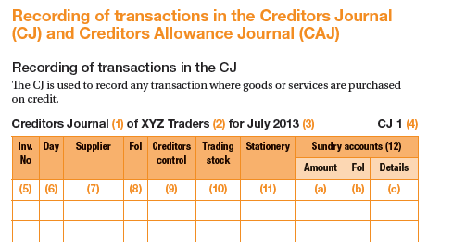
RECORDING OF TRANSACTIONS IN THE CJ

Slide 13
KEY
The name of the subsidiary journal
The name of the business
The time period (month and year) for which transactions are recorded
The page number of the relevant journal
The number of the invoice received from the supplier
The day on which the transaction took place
The name of the supplier
The page number of the supplier’s account in the CL

Slide 14
KEY
9. The amount of each transaction. The Creditors control account is a summary of all transactions relating to credit purchases.
10/ 11. These columns depend on what the business
purchases on credit regularly.
12. Sundry accounts is used for any transaction that is not represented by the analysis columns:
the amount of the transaction
The folio number of the second or opposite account
The name of the contra account

Slide 15
Example
Young Designs Boutique has the following credit purchases for April 2013:
3. Purchased trading stock on credit from Emerald Designs, R2 400 (Inv 34).
5. Purchased stationery on account from PNA, R560 (Inv 1082).
9. Purchased closed on account from Emerald Designs, R2 400 (Inv. 49)
12. Arranged for African Designs to deliver stock, R4 700 (Inv. A394).
15 Purchased new cash register on credit from Office Equipment CC, R10 200 (Inv 156)

Slide 16
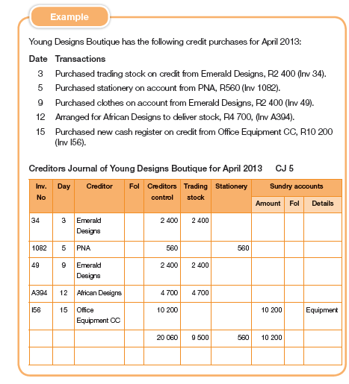
Possible solution

Slide 17
Let’s do it together
Pravin Chetty owns a stationery store with the following transactions for November 20 13
2. Pravin purchased stationery as trading stock from Thomas Wholesalers for R30 000 and received 15% trade discount (invoice LW 345).
5. Quick Pens Ltd. delivered stock of stationery, R26 700 (Inv. 5560).
17.Bought display units from Shelving Supplies on credit, R3 500 (Inv. S219).
23. Purchased trading stock, R12 000, from Thomas
Wholesalers, and received 10% trade discount (LW 430).
30. Pravin sent the delivery vehicle to Coastal Toyota for a service, R2 500 (Inv 1298)

Slide 18
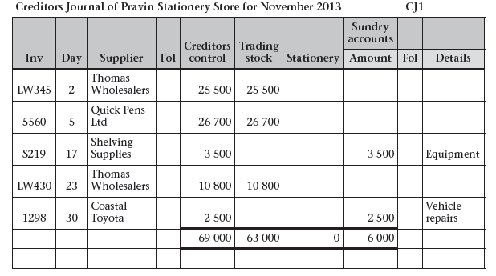
Required:
Explain credit sales
Answer: Credit sales takes place when a business purchases or sells stock on account. The goods are taken immediately but are paid for only at a future date e.g. end of the month.
Draw up the CJ with the following columns: creditors control, trading stock, sundry accounts
Suggested answers
no 2 - 4

Slide 19
Required
Pravin is pleased to get a 15% trade discount from Thomas Wholesalers. Why do you think he is so pleased and how does it affect his business?
Suggested answer: Pravin is pleased as his cost price is now lower and he can charge more, which will increase his profit.

Slide 20
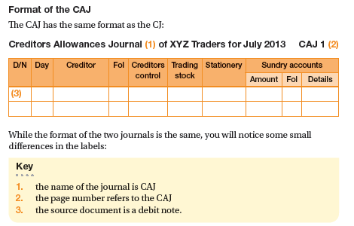
Recording of transactions in the CAJ
Key
While the format of the two journals is the same, you will notice some small differences in the labels:
The name of the journal is CAJ
The page number refers to the CAJ
The source document is a debit note

Slide 21
Example
Young Designs Boutique has the following duplicate debit notes:
5. Returned two ladies shirts that had buttons missing to Emerald Designs, R180 (Debit note 21)
13. African Designes did not subtract the 5% trade discount on invoice A394 for R4 700 (Debit note 22)

Slide 22
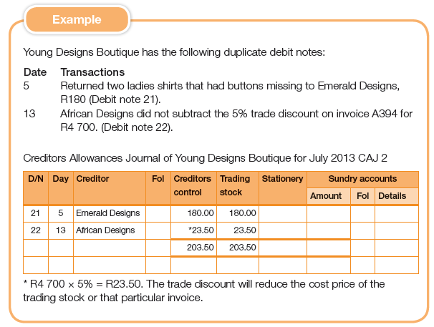
Possible answers

Slide 23
Let’s do it together
Pravin has the following duplicate debit notes for November:
6. R600 notebooks from Quick Pens Ltd were damp when delivered and unsuitable for resale (D/N 34)
17. Returned two shelving units to Shelving Suppliers as they were not used, R200 (D/N 35)
30. Returned the delivery crates to Thomas Wholesalers, R60 refund (D/N 36)

Slide 24
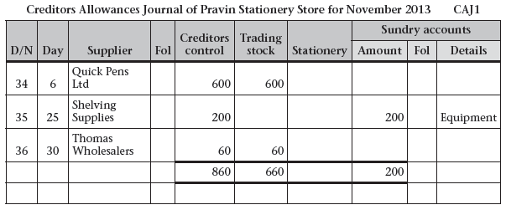
Required:
List three reasons for issuing a debit note in this activity.
Answer: Shelves were returned that the owner did not need; some notebook were damages, a refund was given for the return of packaging crates
Draw up and label the CAJ with the following columns: creditors control, trading stock, sundry accounts

Slide 25
Let’s do it together
Compare the CJ for Pravin Stationery Store in the previous activity and the CAJ
4.1 Calculate the amount Pravin owes his creditors. Show all calculations
Answer: Quick Pens = R26 700 – R600 = R26 100;
Thomas Wholesales: R25 500 + R10 880 = R36 300 – R600 = R36240
Coastal Toyota = R2 500
Total: R26 100 + R36240 + R3 300 + R2 500 = R68 140
4.2 Do you think purchasing on credit is a good idea for this business. Give reasons for your answer

Slide 26
4.2 Do you think purchasing on credit is a good idea for this business? Give reasons for your answer.
Answer: Use discretion with the learners’ answers. They must support their opinion with logical reasons.
Sample answers:
I think purchasing on credit is a good idea if the goods can be sold quickly so that money is received before the goods need to be paid for. It gives Pravin an opportunity to keep a good quantity of stock without affecting his cash flow, as it would, if he pad to pay cash for this stock.

Slide 27
QUESTIONS?

